Slide 1
Risk Scores + Generalized Additive Models

Slide 2
Agenda
Announcements
Optimized Risk Scores
Break
Intelligible Models for HealthCare

Slide 3
Announcements
Homework 2 is out!
Due: October 15th, 11.59pm
Start early!
All students have 2 late days which can be used for any HWs or Checkpoints (not for final report)
Any other accommodations: Harvard Accommodations Office/Resident Dean
Presentations start from next week!
Wanqian
Sophie, Emily, Jorma

Slide 4
Announcements
Support for paper presentations
Dry runs – we can give feedback on your presentation!
Discuss concepts/ideas you have questions about
Look for slides/talks online
Email authors for slides (or we can!)
Paper presentations:
Remember: conveying intuition is the key!
Provide good summaries of what’s in the paper
Use Roadmaps/Agenda
Do not worry if you have picked a highly technical paper – try your best, reach out to us!
For papers that are not technical, we expect you to put “much more” effort into conveying ideas well!

Slide 5
Questions??

Slide 6
Learning Optimized Risk Scores
Berk Ustun, Cynthia Rudin

Slide 7
Contributions
Risk scores: Simple classification models that let users quickly assess risk
Principled approach to learn risk scores
Formulate as a mixed integer non-linear program
New cutting plane algorithm
Obeys complex constraints without parameter tuning; scales linearly; optimal!

Slide 8
Roadmap
Motivation and Examples
Objective Function
Cutting Plane Algorithm
Disadvantages
Lattice Cutting Plane Algorithm
Results

Slide 9
Roadmap
Motivation and Examples
Objective Function
Cutting Plane Algorithm
Disadvantages
Lattice Cutting Plane Algorithm
Results

Slide 10
Motivation
Risk scores are widely used in medicine and criminal justice
E.g., assess risk of mortality in ICU, assess the risk of recidivism
Adoption → decision makers find them easy to understand
Risk scores are built by hand
Ad hoc
By domain experts

Slide 11
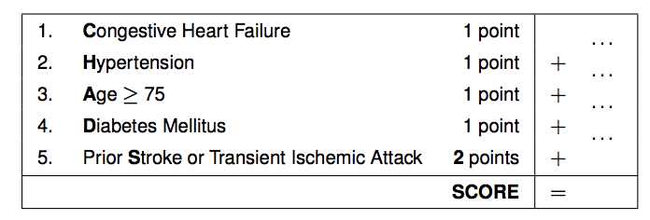
Example

Slide 12
Motivation
How about data-driven risk scores?
Do you think learning risk scores is an important problem?
Why is there very little work on this topic?

Slide 13
Roadmap
Motivation and Examples
Objective Function
Cutting Plane Algorithm
Disadvantages
Lattice Cutting Plane Algorithm
Results

Slide 14
Model Desiderata
Sparse, small integer coefficients
Calibration: risk predictions should match observed risks
Rank accuracy: correctly ranking examples according to their true risk

Slide 15
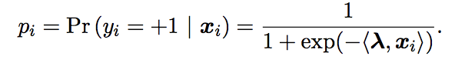
Predicted Risk
Predicted risk that example i is positive:
Likelihood?
Log likelihood?

Slide 16
Mixed Integer Program
Integer Program
An optimization model where any of its decision variables are discrete
Pure Integer Program
All variables are discrete
Mixed Integer Program
Some variables are discrete

Slide 17
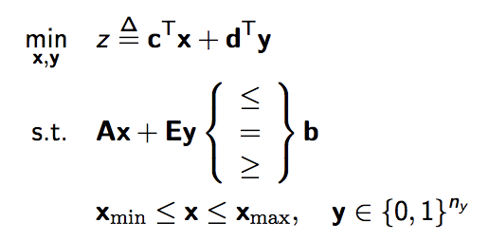
Linear vs. Non-Linear Integer Programs
Integer Linear Program
Objective function and all its constraints are linear
Integer Nonlinear Program
Otherwise
Mixed Integer Linear Program

Slide 18
Mixed Integer Non-Linear Programs
Very difficult to solve
NP Hard
Typical solutions: relaxations
Removing/relaxing certain constraints
Branch and bound: restricting search to promising subspaces
This paper proposes an objective function that is MINLP

Slide 19
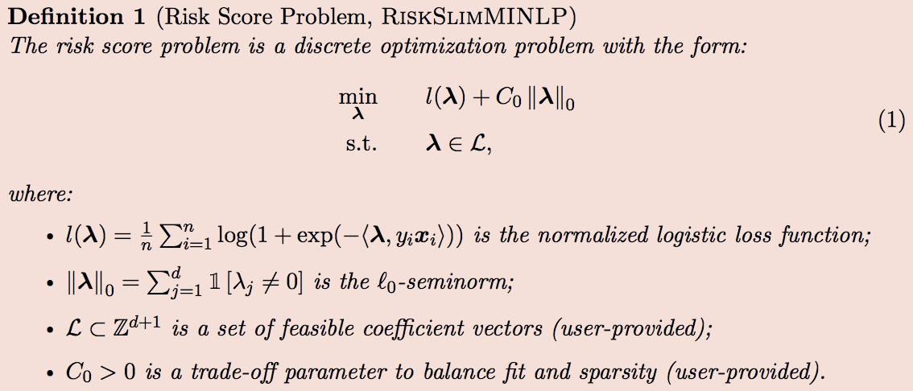
Objective Function
Can you propose alternate objectives which are not MINLP for this problem?
Is this problem even convex?

Slide 20
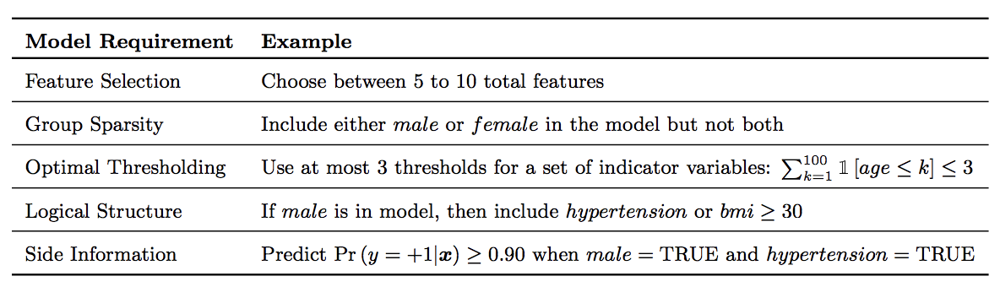
Other Model Requirements

Slide 21
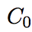
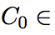
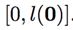
Setting Trade Off Parameter
Setting trade off parameter
Why?
Setting model size in a data driven manner
Different constraints on model size
Fix to a small value (10⁻⁸)
Vary constraints on model size from 1 (only one feature) to d (all features)
Solving d instances of the above problem
Pick the best one

Slide 22
Roadmap
Motivation and Examples
Objective Function
Cutting Plane Algorithm
Disadvantages
Lattice Cutting Plane Algorithm
Results

Slide 23
Cutting Plane Example
Example problem:
min x + y
s.t.
2x + y >= 2
-x + 2y >= -2
x, y are integers

Slide 24
Cutting Plane Example
LP relaxation:
min x + y
s.t.
2x + y >= 2
-x + 2y >= -2
x, y are integers

Slide 25
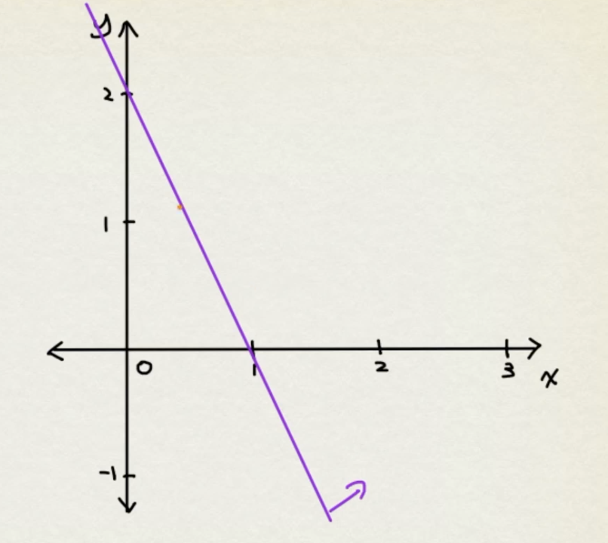
Cutting Plane Example

Slide 26
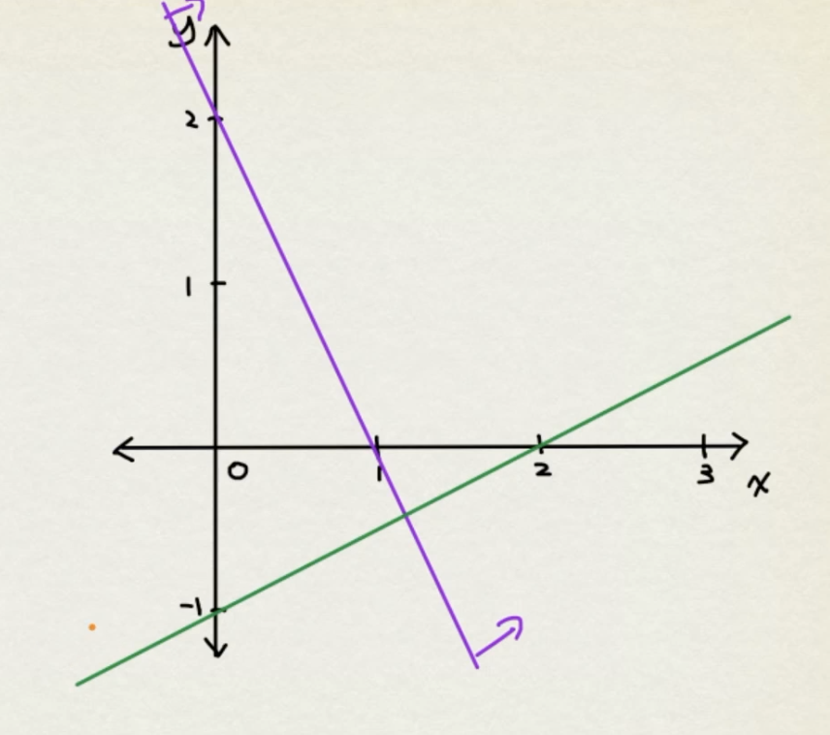
Cutting Plane Example

Slide 27
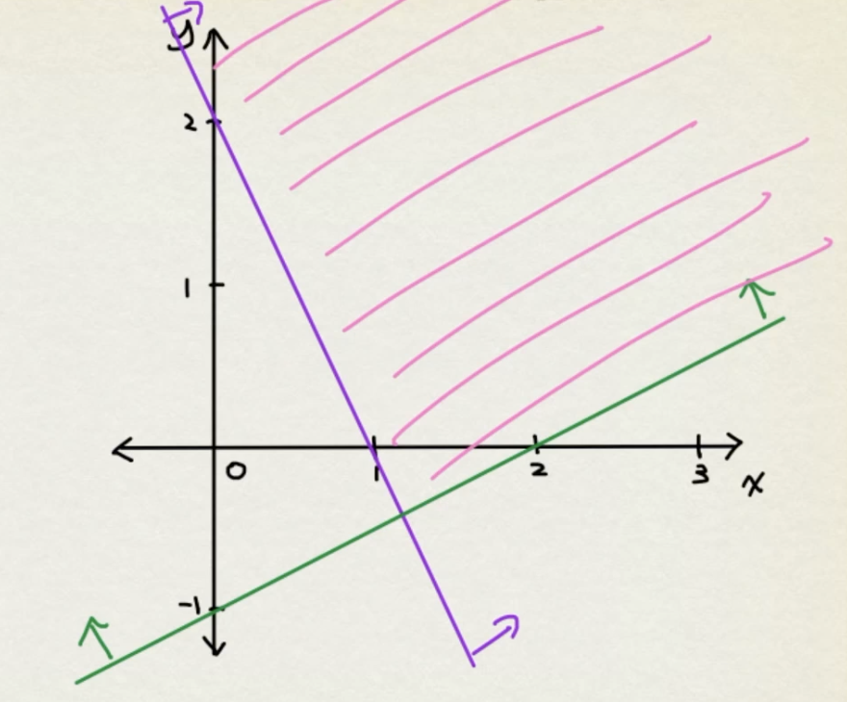
Cutting Plane Example

Slide 28
Cutting Plane Example
Solution of LP = intersection point
[-6/5, -2/5]
If we manipulate the equations of the two constraints we have
y >= -2/5
Since -2/5 is not an integer, y >= 0 is the next constraint that needs to be satisfied

Slide 29
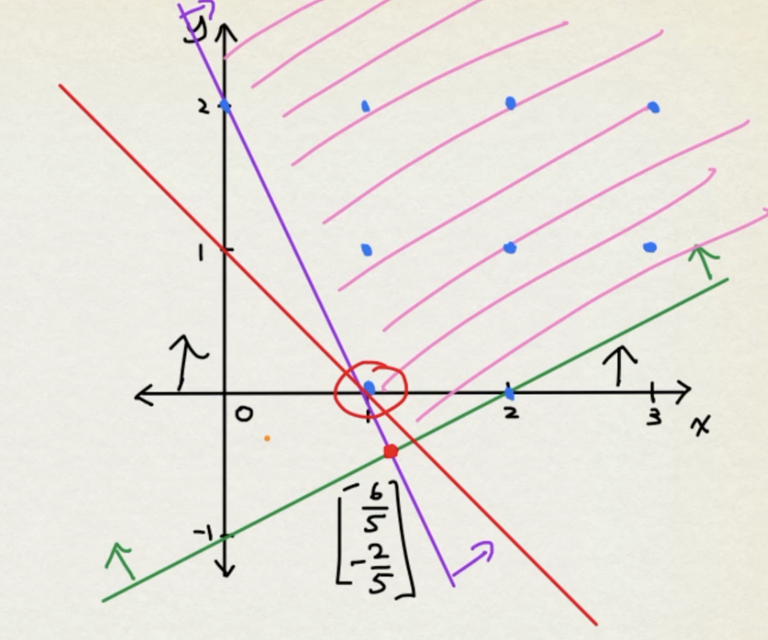
Cutting Plane Example
x = 1, y = 0

Slide 30
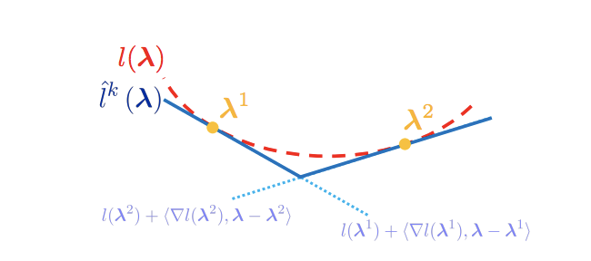
Cutting Plane Algorithm
Approximate the non-linear loss function using multiple linear “cuts”

Slide 31
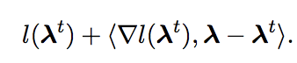
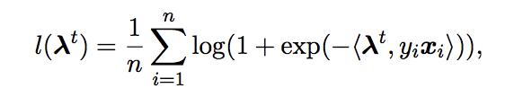
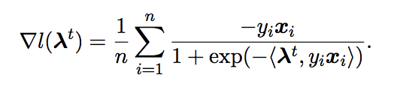
Cutting Plane Algorithm
Each cut is a supporting hyperplane to the loss function
Think about line equation y – y1 = m (x – x1)
y = y1 + m (x – x1)
m = slope = gradient

Slide 32
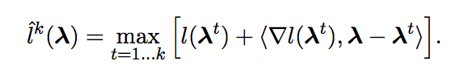
Cutting Plane Algorithm
Cutting plane approximation of the loss function
Pointwise maximum of multiple cuts

Slide 33
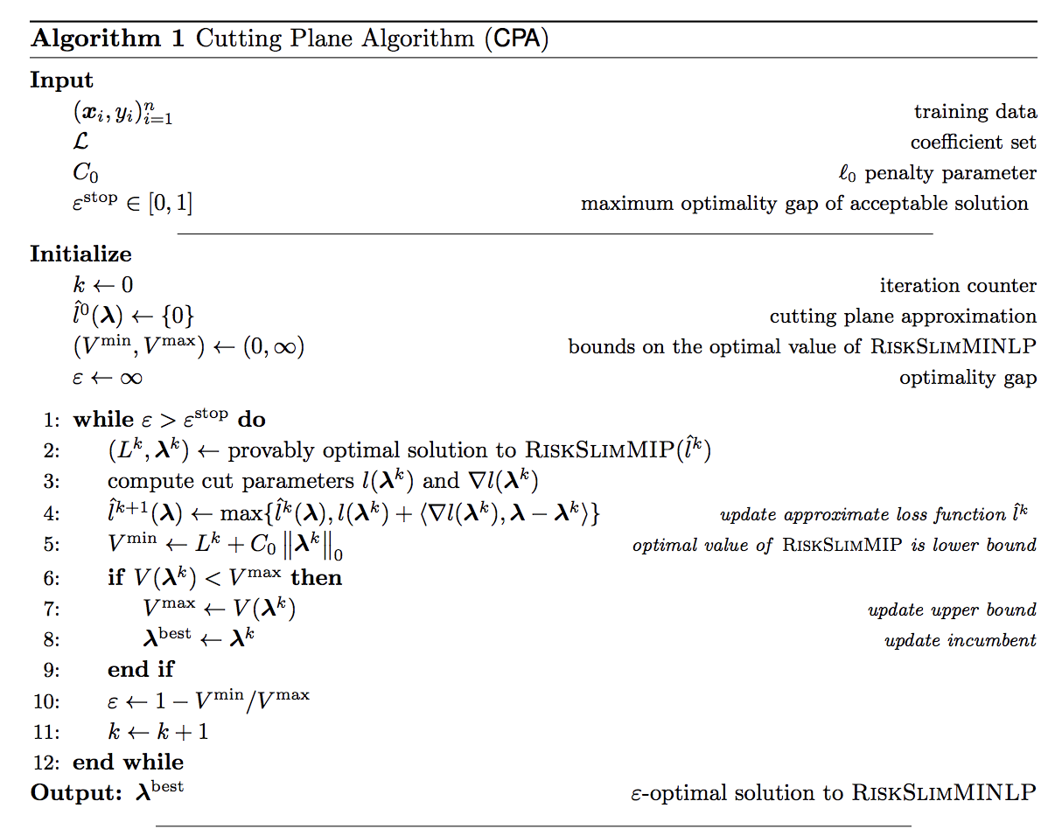
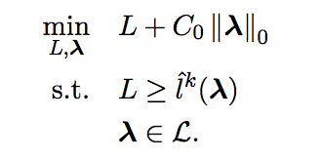
Cutting Plane Algorithm
Surrogate
approximation

Slide 34
Cutting Plane Algorithm
Surrogate
approximation

Slide 35
Convergence of CPA
CPA converges to optimal solution of main objective (MINLP) [Kelley, 1960]
Since the cuts added at each iteration are not redundant, lower bound improves monotonically

Slide 36
Advantages of CPA
Running time scales linearly in n for fixed d
Cut parameters can be computed efficiently
Distributed
Can use MIP solver for surrogate MIP

Slide 37
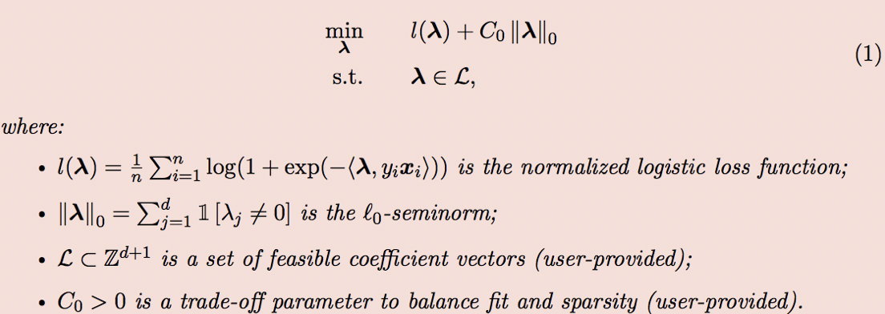
Stalling in Non-Convex Settings
Non-convex regularizers and/or constraints
Surrogate is non-convex
Which part of the main objective is non-convex?

Slide 38
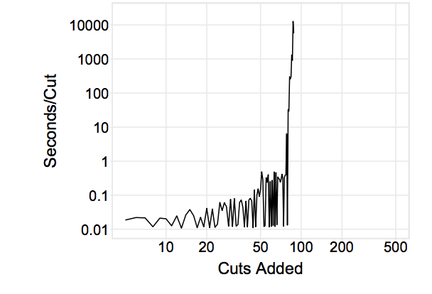
Stalling on 20 features and 50K points
Surrogate becomes increasingly difficult to optimize with each iteration

Slide 39
Stalling Problem
No simple fix – CPA stall on non-convex problems
The algorithm tries to compute a globally optimal solution to a surrogate problem at each iteration
In non-convex cases, this implies finding optimal solution of a non-convex surrogate and certifying there is no better solution

Slide 40
Roadmap
Motivation and Examples
Objective Function
Cutting Plane Algorithm
Disadvantages
Lattice Cutting Plane Algorithm
Results

Slide 41
Lattice Cutting Plane Algorithm (LCPA)
LCPA does not stall
Does not have optimize a non-convex surrogate
Uses branch and bound
Old technique
Recursively split feasible region discarding parts that are infeasible/suboptimal
Solves a surrogate LP over each region

Slide 42
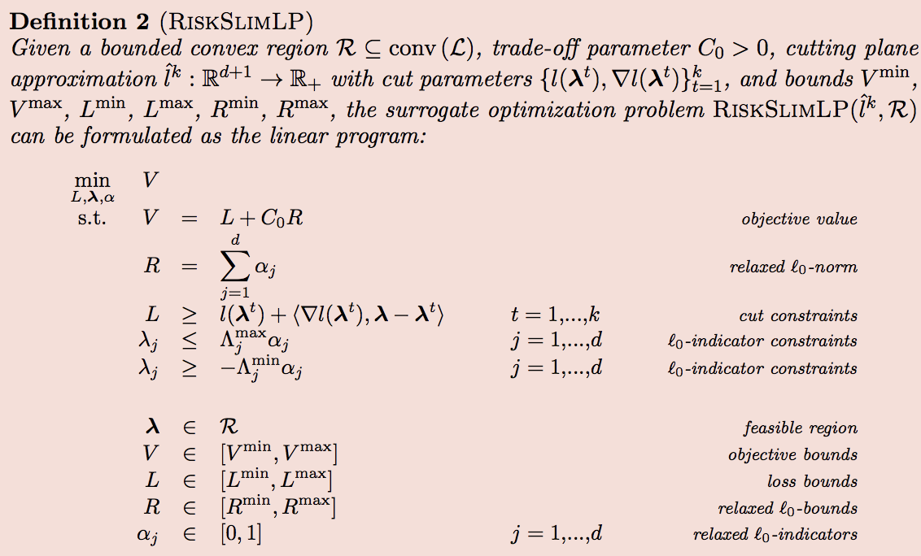
LP Surrogate

Slide 43
Branch and Bound: Intuition
Begin with original MIP
Remove all integrality restrictions
The resulting LP is the linear programming relaxation of MIP
Solve this LP
If the result satisfies integrality constraints, we are done!

Slide 44
Branch and Bound: Intuition
If not, pick some variable which should be integer but is not after solving LP (e.g., x = 5.7)
Denote original MIP by P_{0,} create two child MIPs P₁ and P₂
X <= 5.0
X >= 6.0
Branched on x
Compute solutions to both subproblems and better of these solutions will be the optimal solution for P₀

Slide 45
Branch and Bound: Intuition

Slide 46
Branch and Bound for MINLP
It is precisely doing the same thing as above
If RiskSlimLP of the current (sub) problem has an integer solution, we are done!
Update the cutting plane approximation with a new cut
If RiskSlimLP of the current (sub) problem has a real valued solution a, add child nodes with constraints <= floor(a), >= ceiling(a)
Proceed recursively

Slide 47
Branch and Bound for MINLP
If RiskSlimLP is infeasible, then just don’t proceed down that path in the Branch and Bound Tree
You are basically abandoning any kind of search in that part of the feature space

Slide 48
CPA and LCPA vs. MINLP Commercial
Commercial solvers can handle only small d or n
On larger instances, slow, fails to converge within 6 hours, fails to get high quality solution
CPA can handle small d
Stall on large d (as seen previously)
LCPA can handle large datasets

Slide 49
Additional Improvements/Hacks
Conference version: Not included; Journal version: included;
Polishing heuristic
Rounding heuristic
Bound tightening

Slide 50
Roadmap
Motivation and Examples
Objective Function
Cutting Plane Algorithm
Disadvantages
Lattice Cutting Plane Algorithm
Results

Slide 51
Experimental Evaluation
6 datasets
Integer coefficients [-5, 5]
Model size [include <= 5 variables]
C₀ = 10⁻⁸
5 fold cross validation

Slide 52
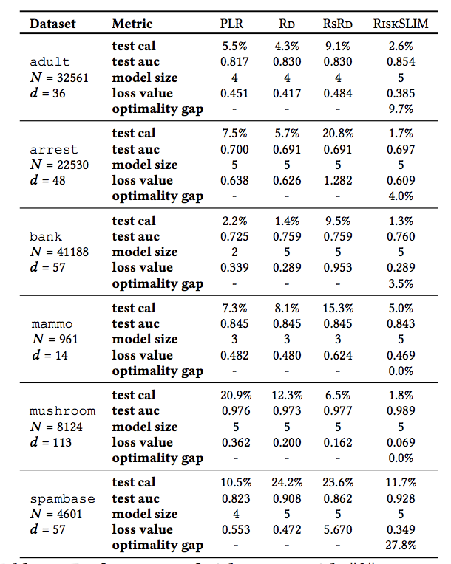
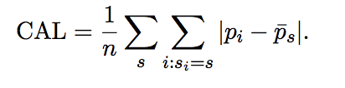
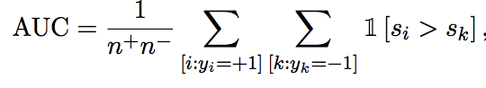
Results

Slide 53
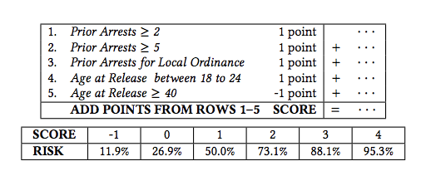
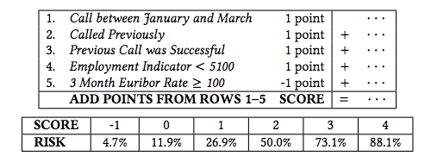
Models Learned for Arrest and Bank

Slide 54
ICU Seizure Prediction
N = 5427 patient records
d = 87 variables
Probability of seizure in next 24 hours = 12.5%

Slide 55
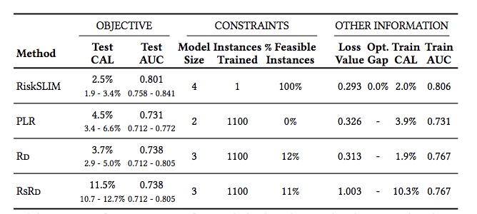
ICU Seizure Prediction

Slide 56
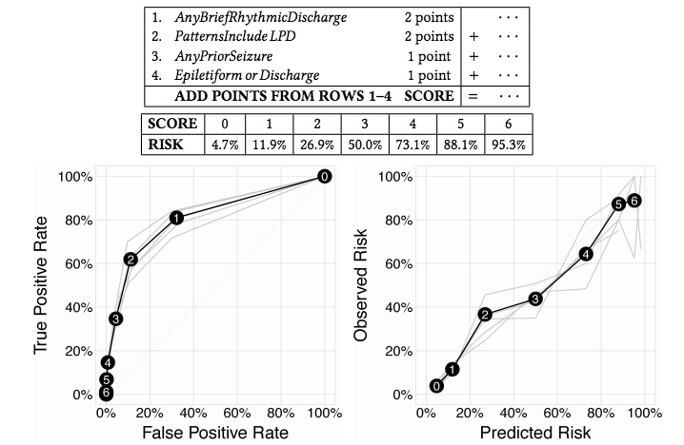
Zoom In: Results with Proposed Model

Slide 57
Questions??

Slide 58
Let’s start the critique!

Slide 59
Intelligible Models for HealthCare
Rich Caruana et. al.

Slide 60
Contributions
Two case studies where Generalized Additive Models (intelligible) yield state-of-the-art accuracy.
Pneumonia risk prediction
30-day hospital readmission
Claim: GAMs is a class of models that can handle interpretability/accuracy trade-off quite well

Slide 61
Roadmap
Motivation
Intelligible Models
Case study: Pneumonia risk
Case study: 30 day readmission
Discussion and Questions

Slide 62
Roadmap
Motivation
Intelligible Models
Case study: Pneumonia risk
Case study: 30 day readmission
Discussion and Questions

Slide 63
Motivation
A large project to evaluate application of ML to healthcare problems
Predicting probability of death (POD) for pneumonia patients
Most accurate models: neural nets (0.86 AUC)
Logistic regression: 0.77
Logistic regression was used instead. Why?

Slide 64
Motivation
Rule based learning method was also used
Insight: HasAsthma(x) → LowerRisk(x)
Counterintuitive?
Rule based system was intelligible making it easy to recognize and remove dangerous rules
Lack of intelligibility made it harder to deploy neural nets because it was difficult to know other problems with the model

Slide 65
Motivation
Many more models but equally unintelligible today
SVMs, random forests, boosted trees
GAMs are both intelligible and accurate!
Editable by experts

Slide 66
Roadmap
Motivation
Intelligible Models
Case study: Pneumonia risk
Case study: 30 day readmission
Discussion and Questions

Slide 67
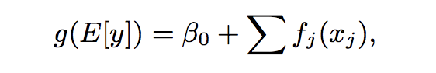
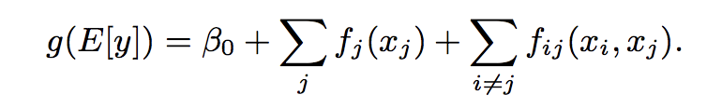
GAMs and GA²Ms
g is a link function: log (E[y] / 1 – E[y]) = RHS
Expected values of each of the fs is 0.

Slide 68
GAMs and GA²Ms
GA²Ms: Build GAM first and and then detect and rank all possible pairs of interactions in the residual
Choose top k pairs
k determined by CV
Learning:
Represent each component as a spline
Optimization problem to balance smoothness and empirical error

Slide 69
Roadmap
Motivation
Intelligible Models
Case study: Pneumonia risk
Case study: 30 day readmission
Discussion and Questions

Slide 70
Pneumonia Risk
14,199 pneumonia patients
train set: 9847
test set: 4352
46 features
Predict POD
10.86% patients died from pneumonia (1542)

Slide 71
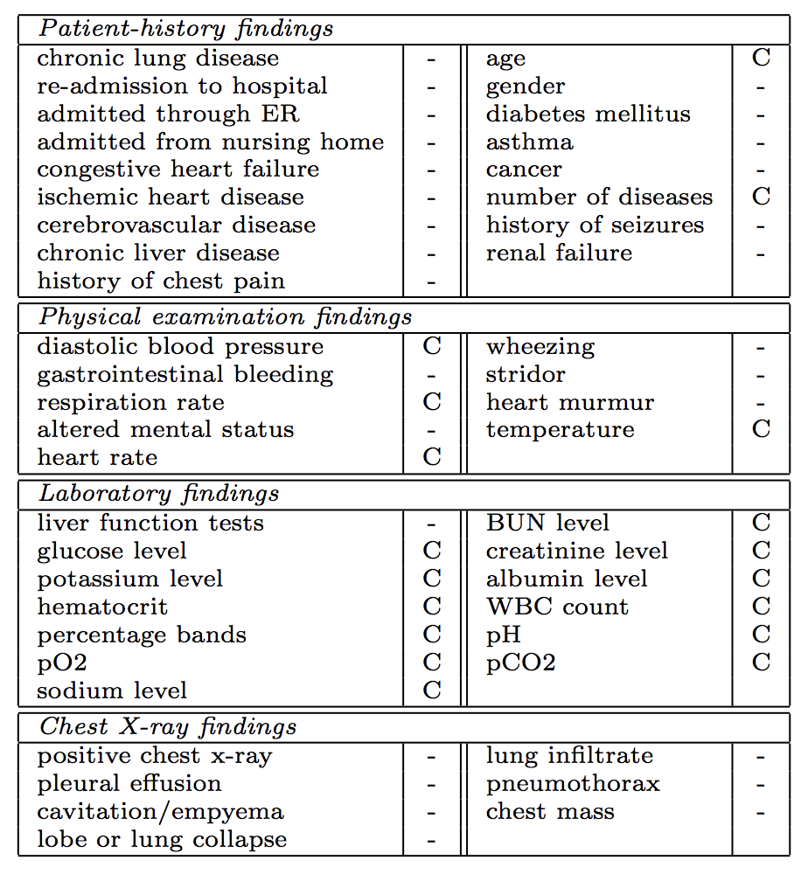
Pneumonia Risk: Features

Slide 72
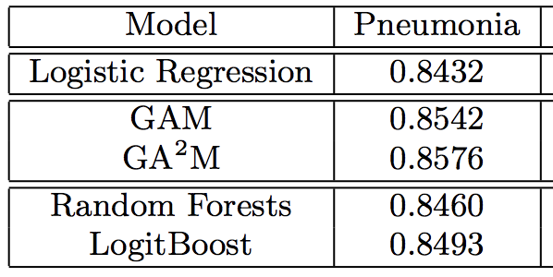
Pneumonia Risk: AUC

Slide 73
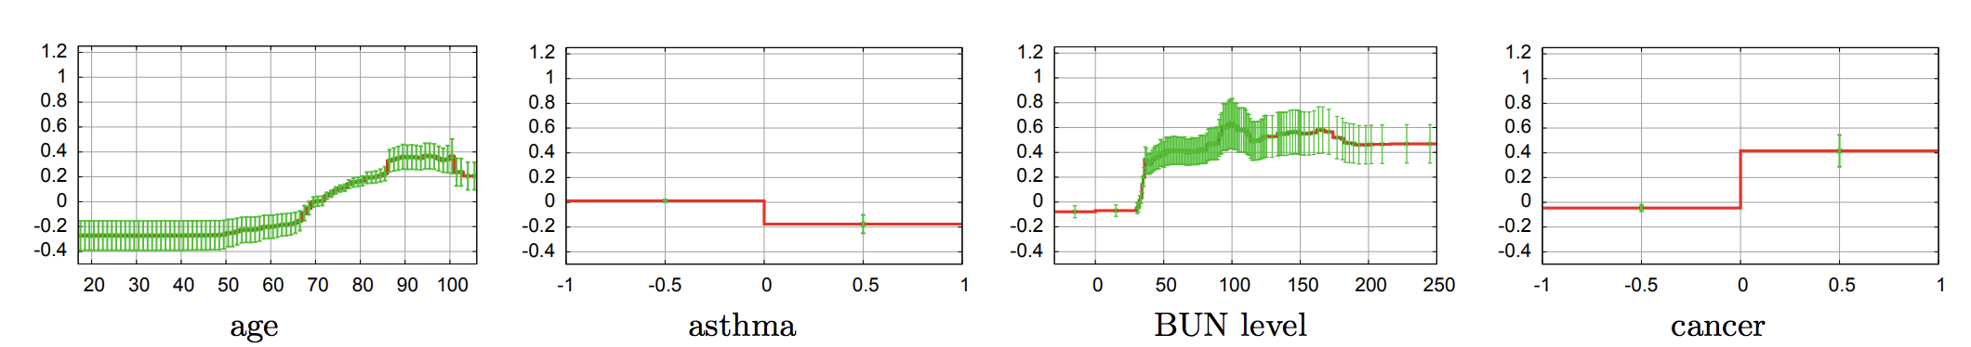
Understanding Outputs of GA²M
Blood Urea Nitrogen
Normal value: 10 to 20
0 means not ordered

Slide 74
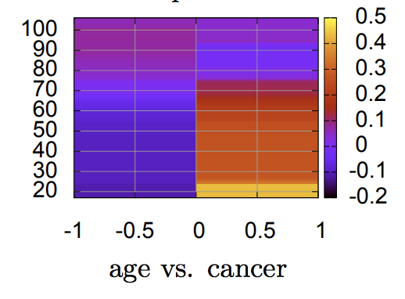
Understanding Outputs of GA²M
Childhood cancers are associated with high risk of death

Slide 75
Roadmap
Motivation
Intelligible Models
Case study: Pneumonia risk
Case study: 30 day readmission
Discussion and Questions

Slide 76
30 day readmission
195K patients in train, 100K patients in test
3956 features
Predict which patients are likely to be readmitted within 30 days of being released
Hospitals with high readmission rates are penalized financially
Did not provide adequate care earlier
8.91% of patients readmitted within 30 days

Slide 77
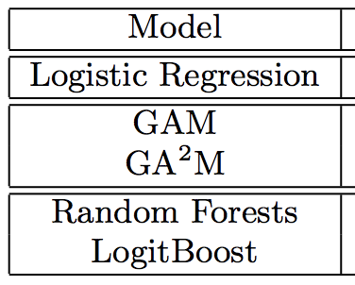
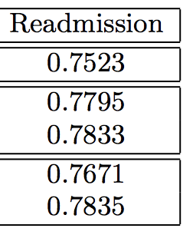
AUC

Slide 78
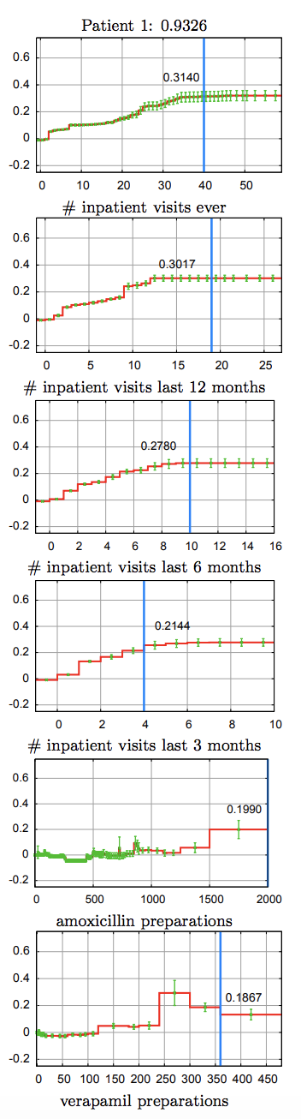
Patient level insights
Lots of admissions
Received lot of
Amoxycilin (strep/pneumonia)
3. Verapamil (hypertension)
p(risk) = 0.9326

Slide 79
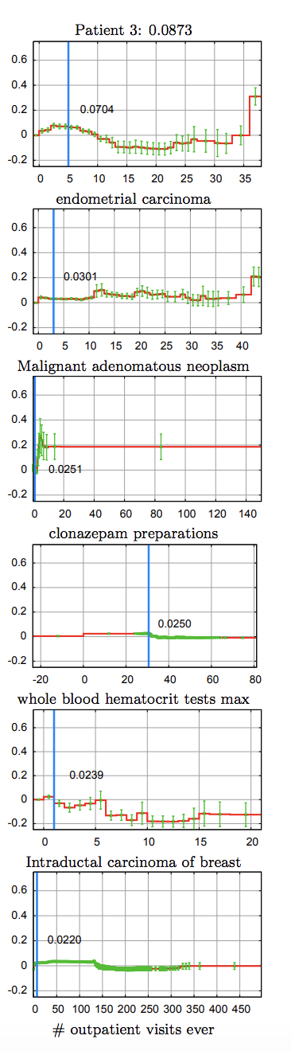
Patient level insights
Lots of admissions
Received lot of
Amoxycilin (strep/pneumonia)
3. Verapamil (hypertension)
1. Post menopausal
2. Cancers that
respond well to treatment
3. Not hospitalized much
p(risk) = 0.9326
p(risk) = 0.0873

Slide 80
Roadmap
Motivation
Intelligible Models
Case study: Pneumonia risk
Case study: 30 day readmission
Discussion and Questions

Slide 81
How to Interpret Risk Scores?
Each term returns a risk score
Probability = 1/(1 + exp(-1 * total risk score))
Pneumonia and 30 day readmission have baseline rates near 0.1 → baseline risk score = -2.197
Patients above baseline risk have higher probability of death/readmission

Slide 82
Modularity
Bias term + contributions of individual features + contributions of pairwise interactions
Mean of contribution terms is zero
This structure helps us clearly understand the model

Slide 83
Sorting Terms By Importance
For each patient, we can compute which term is resulting in what risk score
Rank terms based on the values of risk score
This ranking tells us which features are contributing to the risk of each patient

Slide 84
Feature Shaping vs. Expert Discretization
Instead of GAMs learning function shapes, experts could also provide inputs by discretizing features
Expert discretized features were used for logistic regression model
However, GAMs outperformed LR indicating that feature shaping is valuable

Slide 85
Correlation != Causation
GAMs and GA²Ms are intelligible
But, they are not causal
What we see in plots are associations captures from the data but are not causal implications
It is often easy to confuse intelligibility of predictive models with causality
Please don’t make that mistake!

Slide 86
Questions??

Slide 87
Let’s start the critique!

